Slide 1
Blog with API
Alfonso García de la Santa Medina

Slide 2
LEARNED LESSONS:
Sync management with $.ajax()
Shorthands($.get(), $.post()...)
Differences attr() vS prop()
JQuery

Slide 3
LEARNED LESSONS:
Versions changes
Work applying classes
Main Bootstrap’s design patterns
Bootstrap

Slide 4
Work Development
Dynamic posts loading
Each posts shows its details when clicked
Posted by posts info
Getting all post’s comments
Modifying/deleting posts
Goals

Slide 5
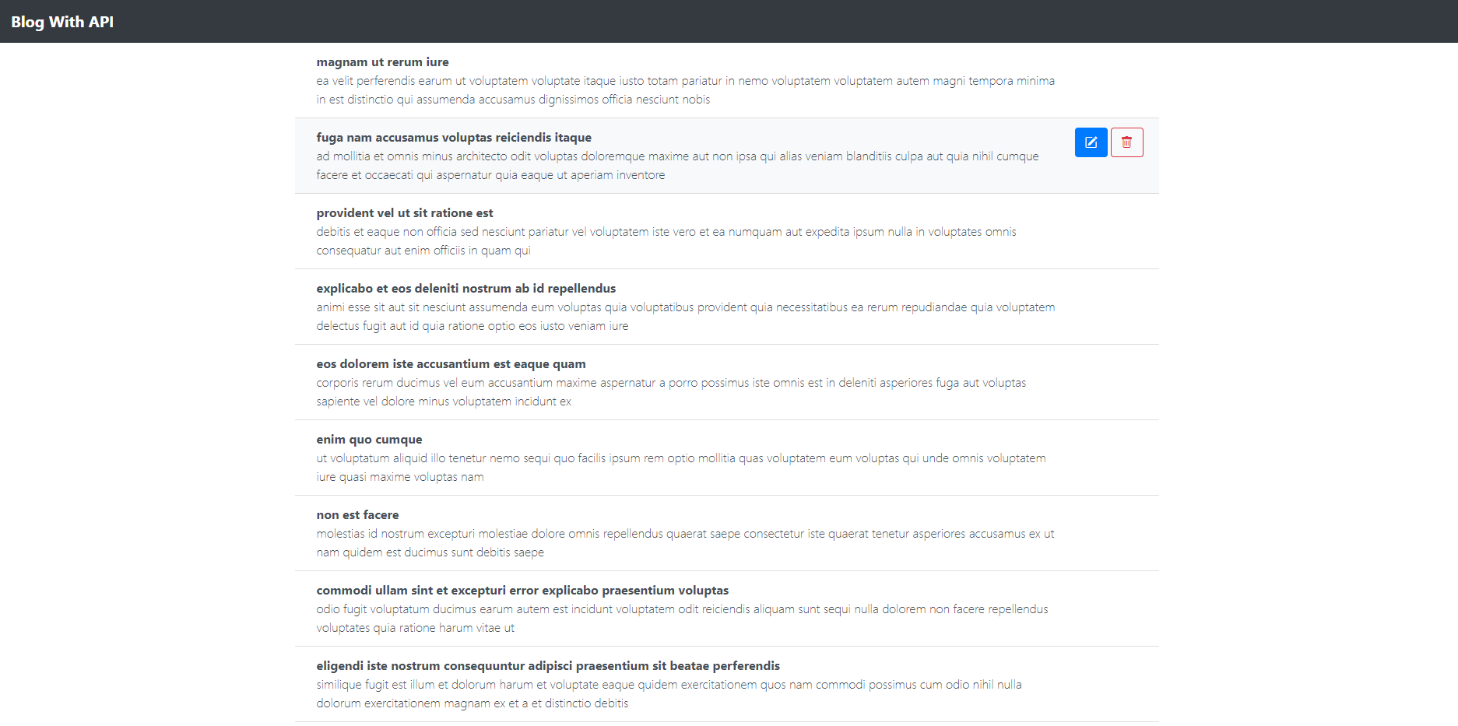
Posts List

Slide 6
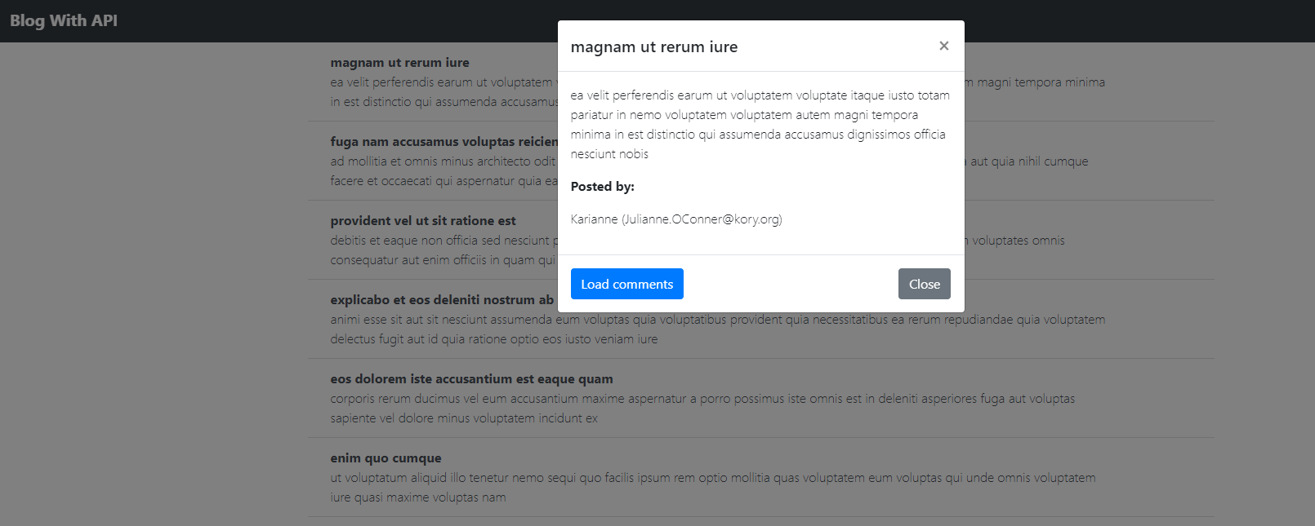
Details Modal

Slide 7
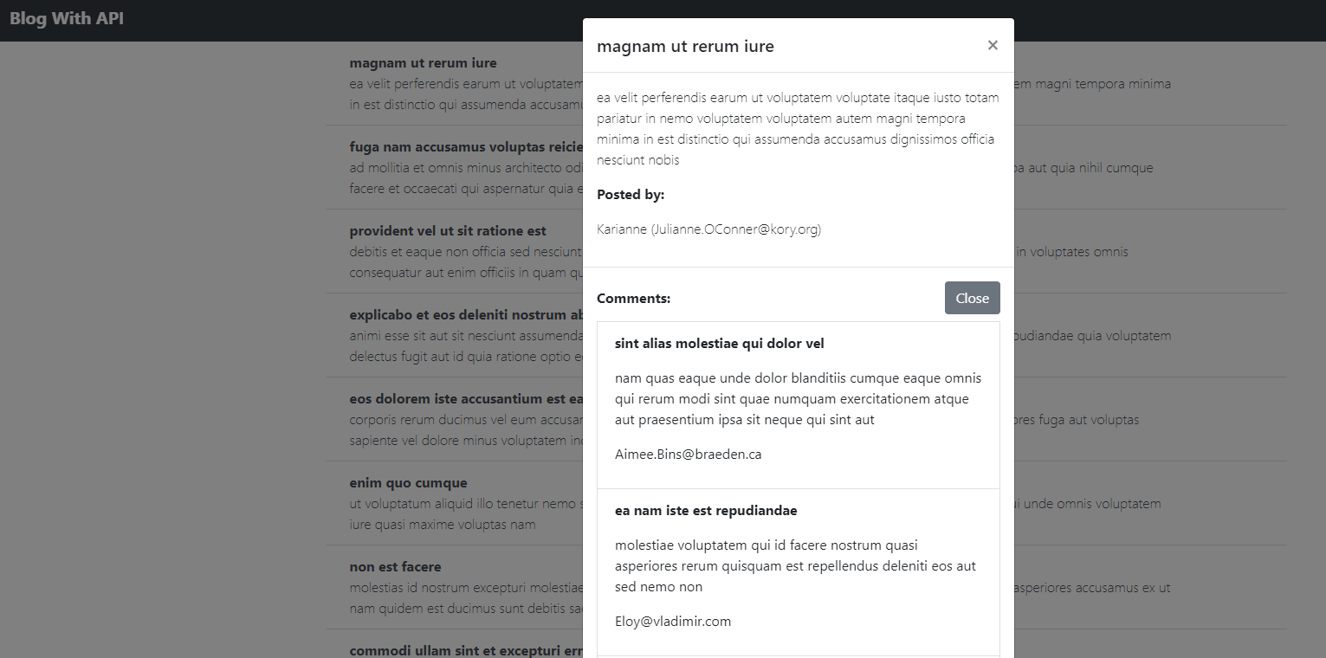
Post Comments

Slide 8
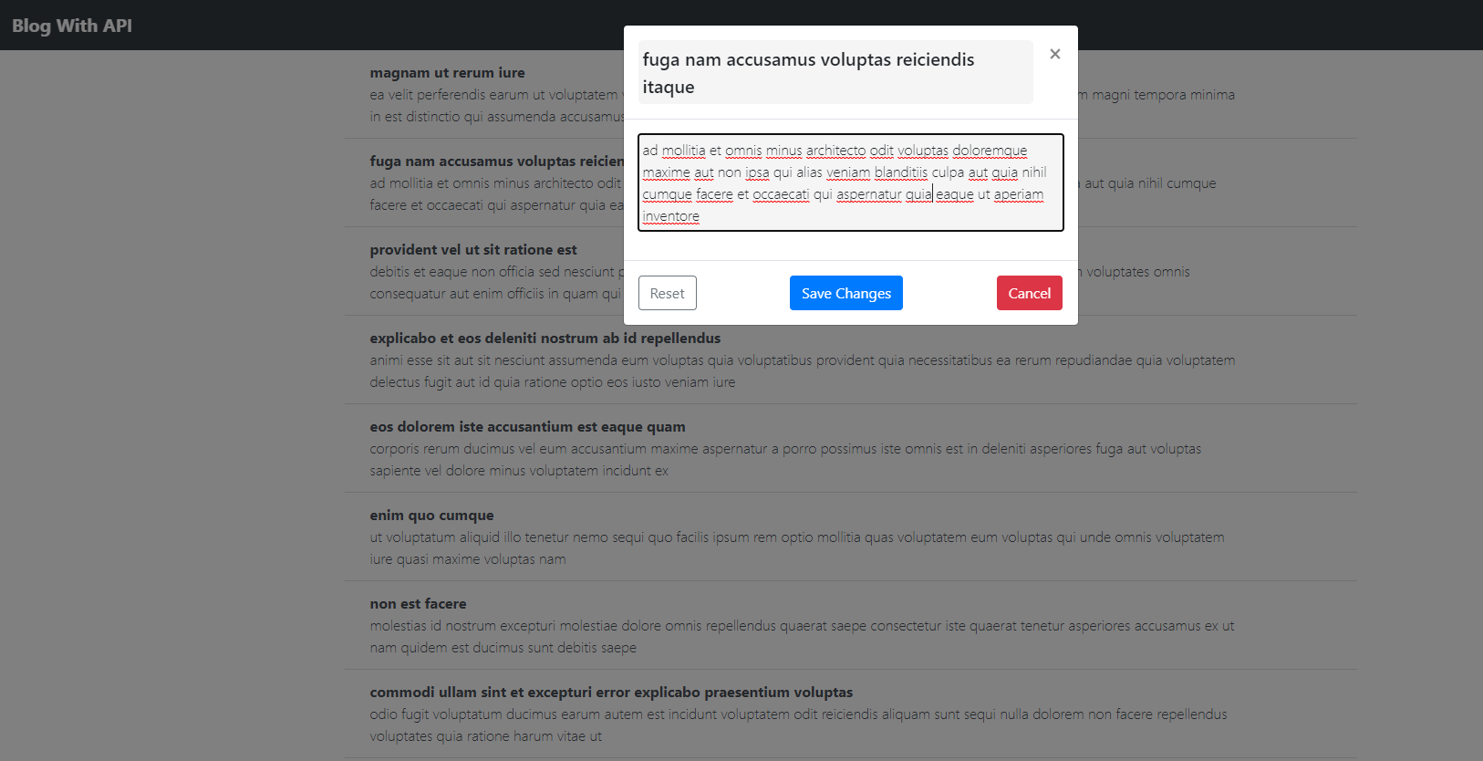
Edit Post

Slide 9
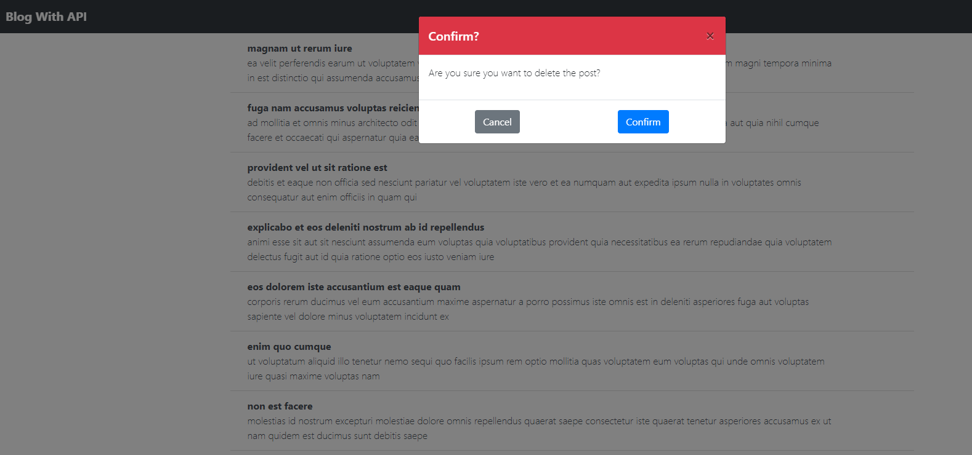
Confirm Required

Slide 10
DEMO
Any question?

